Slide 1
The "Tetris" game
Zaichikova Valeriia
Kravchenko Egor
Zlobin Dmitry
23930

Slide 2
Contents
Introduction
Purpose and area of application
Functional characteristics
Technical characteristics
Conclusion

Slide 3
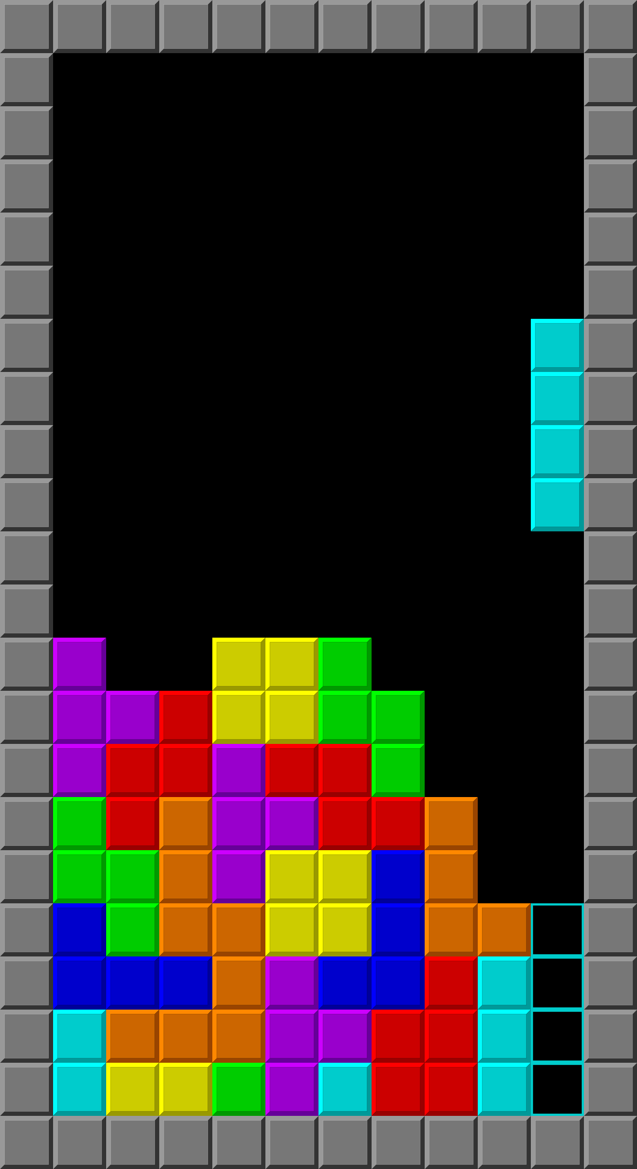
Introduction
Number of full lines | Score for them
1 | 100
2 | 300
3 | 700
4 | 1500
Standart lines-to-score comparsion
Classic example of Tetris gameplay

Slide 4
Purpose and area of application
The objective of the program is to implement it on low-level platforms such as assembler and logic circuits
The program is designed for use in gaming and entertainment spheres

Slide 5
FUNCTIONAL CHARACTERISTICS (SOFTWARE)
The software part (assembly code) for our project is used to generate random figures for the gameplay.
The Random Generator in this project is using the «bag» system. In this system, a list of figures is placed in a «bag», after which they are randomly removed from it one by one until the «bag» is empty.

Slide 6
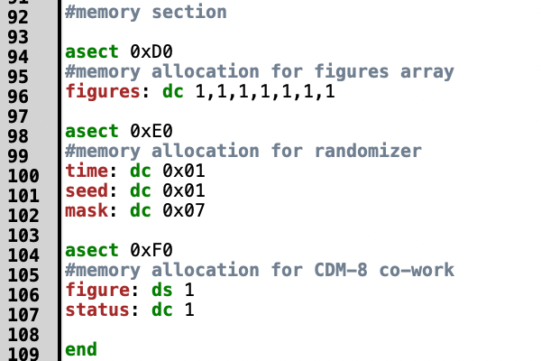
1 Code parts’ description
Code parts’ description
A section of code for allocating memory for a "bag", components for a random number generator and working with the CdM-8 processor

Slide 7
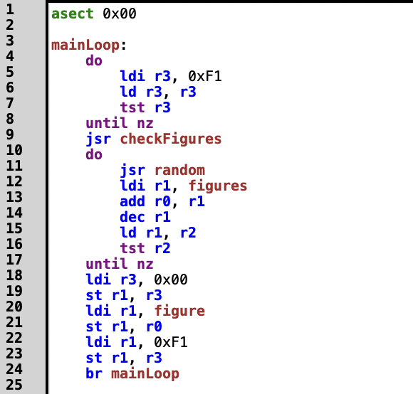
CODE PARTS’ DESCRIPTION
The main cycle of the program, in which a request for a new figure from hardware is expected. After that, a random number is generated and it is checked whether it is available. Next, it records which number was used and is sent to the hardware

Slide 8
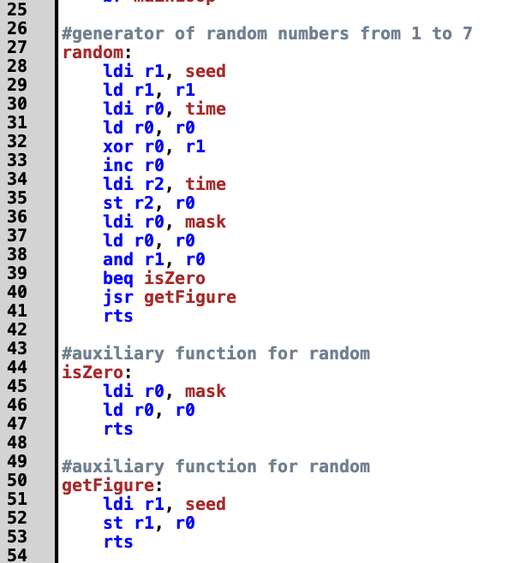
Code parts’ description
A function for generating a random number by using a timer and seed, as well as a mask that limits the range of numbers from 0 to 7, after which a check is performed if the number is not 0. This is a feature of the program. At the end, the function returns the resulting number for further use by the program

Slide 9
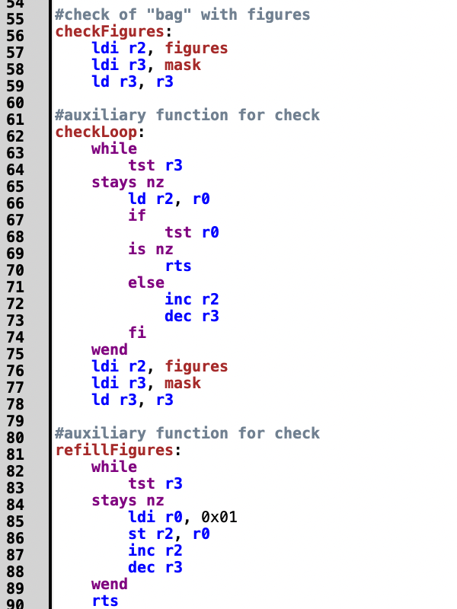
CODE PARTS’ DESCRIPTION
The next part of the code checks the fullness of the "bag" and fills it again if necessary

Slide 10
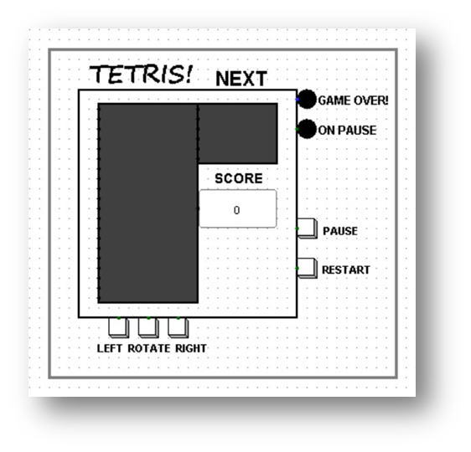
Technical characteristics (HARDWARE)
The Output Display

Slide 11
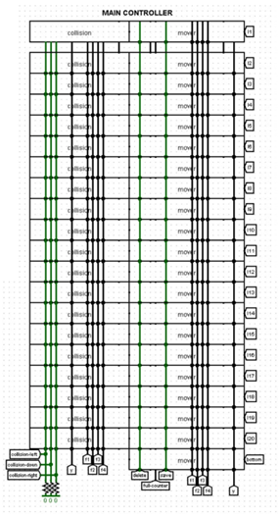
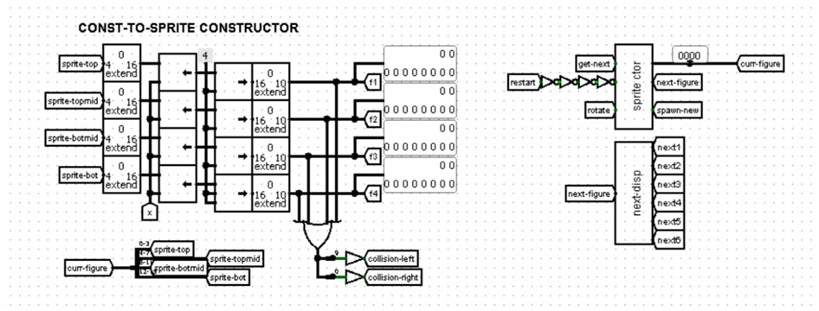
The field subcircuit
Main controller
Const-to-sprite constructor

Slide 12
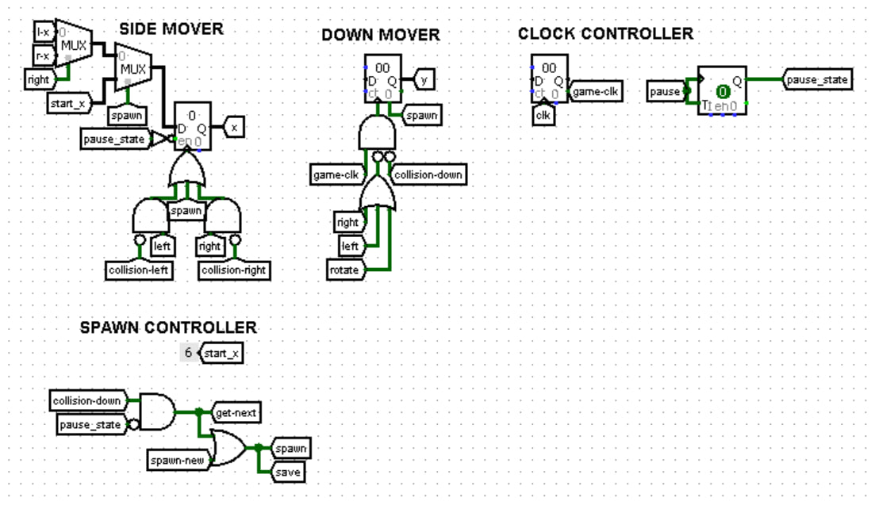
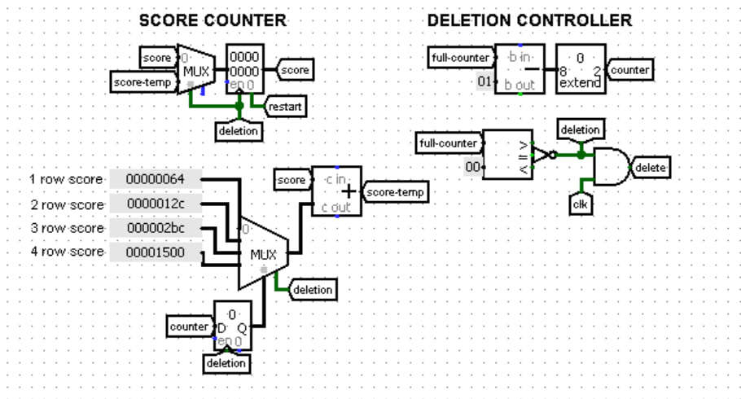
THE FIELD SUBCIRCUIT
Move controller
Score counter and deletion controller

Slide 13
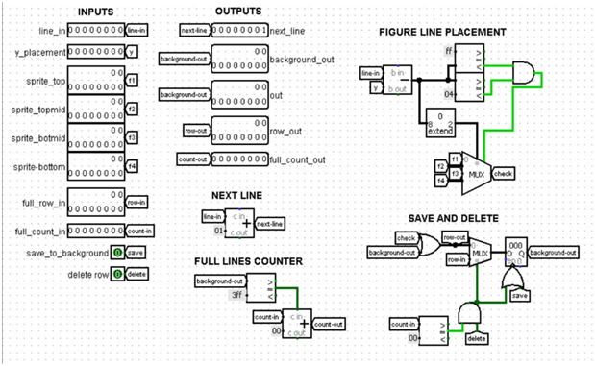
Sprite Control subcircuit

Slide 14
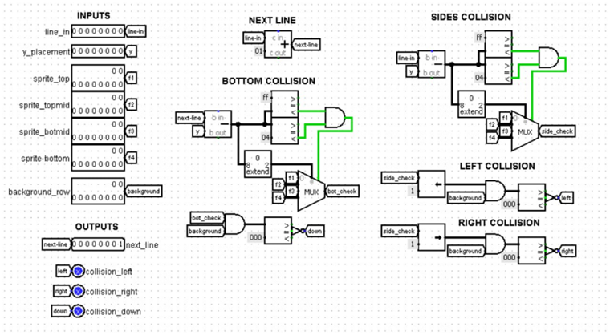
Collision subcircuit

Slide 15
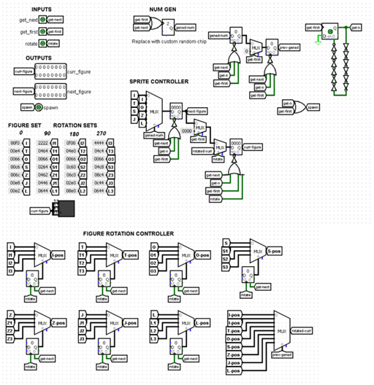
Get Figure subcircuit

Slide 16
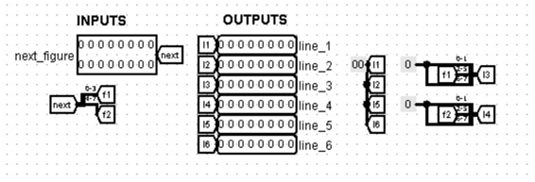
The Output on the Second Display subcircuit

Slide 17
GAME DEMONSTRATION

Slide 18
CONCLUSION
The project of implementing the Tetris game on assembler and through logic circuits has been successfully completed.

